Slide 1




NEXT GEN EMPLOYABILITY PROGRAM
Creating a future-ready workforce
Student Details
College Name
Student Name: Dinesh kumar S
Student ID : au513521104013
Annai Mira College of Engineering and Technology
Notes:
1

Slide 2

CAPSTONE PROJECT SHOWCASE
Project Title
Building Bus Reservation System using Python and Django
Abstract | Problem Statement | Project Overview | Proposed Solution | Technology Used | Modelling & Results | Conclusion

Slide 3
Abstract
Purpose:The project aims to develop a web-based platform that allows users to easily search for available bus routes, select seats, and make reservations online, providing a convenient and efficient way to plan and book bus travel.
Features:The system will include features such as user authentication, bus management (including routes, schedules, and availability), a reservation system with seat selection and also cancelling the booked buses.
Technology Stack:Built using Python and the Django web framework, the project utilizes Django’s built-in authentication system for user management, and integration with third-party payment gateways for secure transactions.
Objective:By creating an intuitive and user-friendly interface, the project aims to streamline the bus reservation process, enhancing the overall experience for both passengers and bus operators while providing a robust and scalable solution for managing bus reservations online.

Slide 4
Problem Statement
User Interface:
Create an intuitive and user-friendly interface for passengers to easily search for buses, select seats, and make reservations.
Ticket Management:
Implement a system to manage ticket availability, seat selection, and booking confirmation.
Payment Gateway Integration:
Integrate a secure payment gateway to facilitate online transactions for ticket reservations.
Admin Panel:
Develop an admin panel to manage bus schedules, routes, ticket prices, and view booking details.

Slide 5
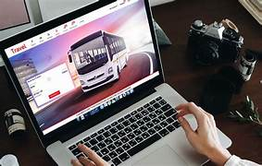
Project Overview
Objective:
The project aims to develop a bus reservation system to facilitate easy booking of bus tickets for passengers and streamline the ticketing process for bus operators.
Scope:
The system will include features such as user registration, bus search and booking, seat selection, payment processing, and an admin panel for managing bus schedules, routes, and bookings.
Technology Stack:
The system will be built using Django for the backend. The frontend will be developed using HTML, CSS, and JavaScript, with Bootstrap for styling.
Expected Outcome:
The project will result in a fully functional bus reservation system that provides a seamless booking experience for passengers and efficient management tools for bus operators.

Slide 6
Proposed Solution
Online Booking System:
Implement a web-based platform where users can search for buses based on their preferences such as departure city, destination, date, and time. They can then select available seats and make reservations online.
Seat Selection and Reservation:
Develop a system that allows users to view the layout of the bus and choose their preferred seats. Once selected, the system should reserve the seats for a specific duration to allow the user to complete the booking process.
Integration with Payment Gateway:
Integrate a secure payment gateway to enable users to pay for their bookings online. The system should support various payment methods such as credit/debit cards, net banking, and digital wallets.

Slide 7
Bus Management Dashboard:
Provide bus operators with a dedicated dashboard to manage their services. This dashboard will allow operators to add new buses, update routes and schedules, manage seat availability, and track bookings in real-time.
Dynamic Seat Selection:
Implement a dynamic seat selection feature that allows users to view and select available seats on the bus. Users should be able to see which seats are already booked and choose their preferred seating arrangement.
Real-Time Availability Updates:
Ensure that seat availability information is updated in real-time to provide users with accurate and up-to-date information. This will prevent overbooking and reduce the likelihood of conflicts during the reservation process.
Source :

Slide 8
Secure Payment Integration:
Integrate a secure payment gateway to facilitate online transactions for bus reservations. Users should be able to pay using various payment methods, such as credit/debit cards, mobile wallets, or net banking, with confidence in the security of their personal and financial information.
Email Notifications:
Set up automated email notifications to confirm bookings, provide booking details, and send reminders about upcoming trips. These notifications will enhance the user experience and keep users informed throughout the reservation process.
Feedback and Support:
Include features for users to provide feedback on their booking experience and seek support in case of any issues or concerns.
Admin Dashboard:
Create an admin dashboard to manage bus schedules, routes, seat availability, and bookings. The dashboard should provide real-time updates and insights to help administrators make informed decisions.
Source :

Slide 9


Technology Used
Front-end
Back-end
Source :

Slide 10
Modelling & Results
MODELLING:
Database Modeling: Utilize Django's ORM to design and implement the database schema for the project. Define models for buses, routes, schedules, reservations, users, and any other relevant entities. Establish appropriate relationships between these models (such as one-to-many or many-to-many) to accurately represent the data structure.
User Interaction Modeling: Model the user interaction flow through wireframes or mockups to visualize the user interface design. Consider the user journey from searching for bus routes to making a reservation and receiving confirmation. Iterate on the designs based on usability testing and feedback to optimize the user experience.
RESULTS:
User satisfaction on using our website .
Easier way of booking the tickets in the easier and in the efficient way
Source :

Slide 11
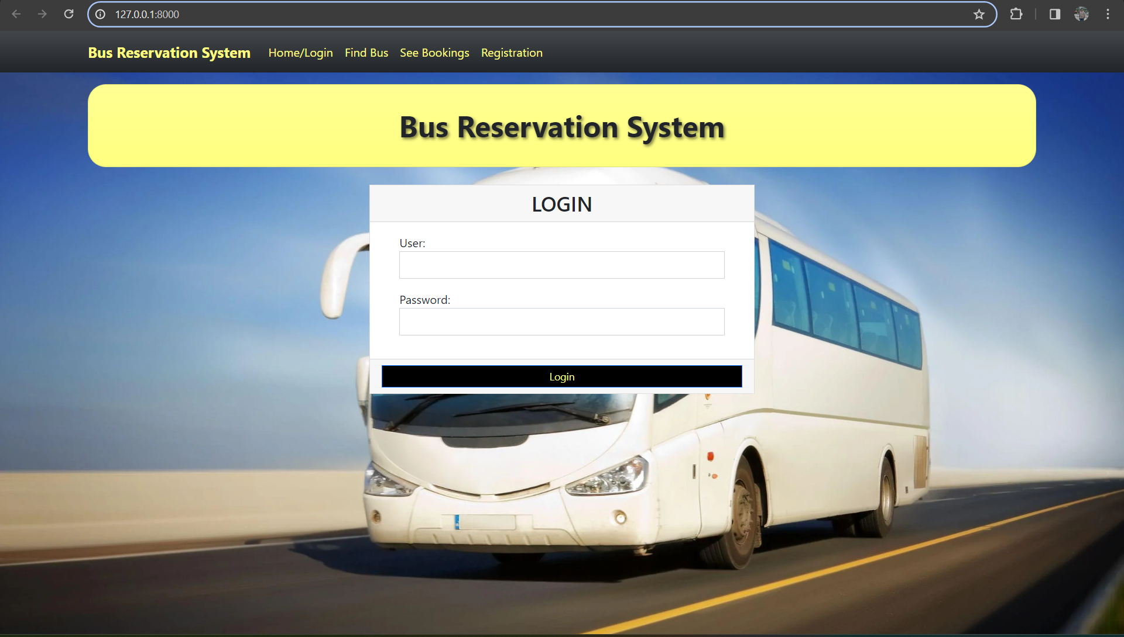
Homepage
The Home page consists of a friendly interface and easier navigation to all the pages like Find Bus, See Bookings and Registration pages .
It provides easy access so that all people can use the website without any issues

Slide 12
About-Us-Page
Company Overview:
Provide a brief overview of the company operating the bus reservation system, including its history, mission, and values.
Team Members:
Introduce key team members involved in developing and managing the reservation system, highlighting their expertise and roles.
Service Offerings:
Describe the services offered through the reservation system, such as ticket booking, route information, and customer support.
Contact Information:
Provide contact details, including address, phone number, and email, to allow users to reach out for inquiries or support.

Slide 13
Service-Page
Bus Ticket Booking:
Provide a comprehensive search functionality for users to find buses based on their preferences such as date, time, and route. Allow users to select seats and make reservations easily.
Real-time Availability:
Display real-time availability of seats on different buses, giving users up-to-date information to make informed decisions.
Payment Gateway:
Integrate a secure payment gateway to process online transactions smoothly, ensuring a seamless booking experience for users.
Booking Management:
Allow users to manage their bookings, including viewing and modifying reservations. Provide booking confirmation and e-ticket generation for convenience.

Slide 14
Departments-Page
Department Overview:
Provide a brief description of each department within the bus reservation system, such as Ticketing, Operations, Finance, and Customer Service. This overview should highlight the role and responsibilities of each department in the system.
Department Contacts:
Include contact information for key personnel in each department, such as email addresses or phone numbers. This allows users to easily reach out for assistance or inquiries related to their bookings.
Department Services:
Detail the specific services offered by each department. For example, Ticketing handles ticket reservations, Operations manages bus schedules and routes,
Department Updates and Announcements:
Provide a section for departments to post updates, announcements, or changes in services. This helps keep users informed about any relevant information that may affect their travel plans or bookings.

Slide 15
Future Enhancements:
Integration with Travel Agencies:
Partnering with travel agencies to offer bundled services such as hotel bookings, tour packages, and travel insurance along with bus tickets.
Mobile App Development:
Developing a mobile app to allow passengers to book tickets, track buses in real-time, receive notifications, and access their booking history on the go.
Enhanced Analytics:
Implementing advanced analytics to gather insights on booking patterns, popular routes, and passenger demographics to optimize bus schedules and improve service efficiency.
Accessibility Features:
Adding features such as voice-enabled search, support for multiple languages, and compatibility with screen readers to make the system more accessible to all users.

Slide 16
Conclusion
Improved User Experience:
The Bus Reservation System significantly improves the booking experience for passengers by providing a user-friendly interface and streamlined booking process.
Efficient Ticket Management:
The system efficiently manages ticket availability, seat selection, and booking confirmation, reducing errors and ensuring a smooth booking process.
Secure Online Transactions:
Integration with a secure payment gateway enables passengers to make online transactions safely and conveniently, enhancing the overall booking experience.
Enhanced Operational Efficiency:
The system's admin panel allows bus operators to manage schedules, routes, and ticket prices effectively, leading to improved operational efficiency and better decision-making.
Source :

Slide 17
Thank You!
Notes:
Thank You !!

